Slide 1
Number recognition from given number image
Presented by
Name: Joyanta Dutta
ID: 1402710200740
Batch: 27th
Premier University, Chittagong

Slide 2
Goal
The main goal of this project is recognizing the number from the given numbers image, basically it is pattern matching way to find the number, which is required to find.

Slide 3
Motivation
By using this project, we can get the matched pattern from a numbers template. We can use this project to find the numbers from a template.

Slide 4
Application
Pattern recognition is used in any area of science and engineering that studies the structure of observations. It is now frequently used in many applications in manufacturing industry, healthcare, and the military. These are the applications of this, Number recognition, Image identification, Reading machine for blind, Digit or letter recognition etc.

Slide 5
Limitation
Pattern recognition process is quite complex and lengthy, which consumes time. The dataset needs to be large for accuracy. The logic is not certain of object recognition. We have to search the numbers one by one. Multiple numbers can’t be searched by this code.

Slide 6
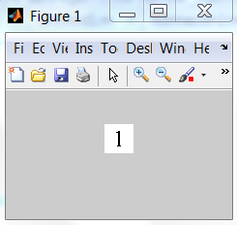
Framework
Fig 0.1: Numbers candidate template (Converted to binary image)

Slide 7
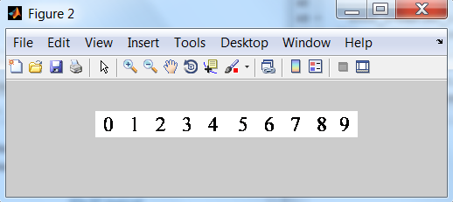
Fig 0.2: Template (Converted to binary image)

Slide 8
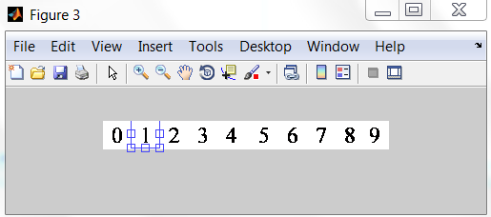
Fig 0.3: Template of Matched pattern

Slide 9
Processing Example
clc();
clear all;
close all;
ImageRead = imread('D:\Last Semester\PR\PR lab\Project\numbers (times new roman) templates\1_candidate.jpg');
ImageR = imread('D:\Last Semester\PR\PR lab\Project\numbers (times new roman) templates\Template_1.jpg');
cit = rgb2gray(ImageRead);
ct = rgb2gray(ImageR);
t = graythresh(cit);
ty = graythresh(ct);
bic = im2bw(cit, t);
imshow(bic);
bit = im2bw(ct, ty);
figure(), imshow(bit);

Slide 10
N=length(bic);
xf=bit;
win_num=size(xf,2);
M0=size(bic,2);
ccor=NaN(M0-1,win_num);
for col=1:win_num
for m=1:M0-1,
[step1,step2,step3]=deal(0);
for n=1:N-m,
step1=step1+xf(n,col)*xf(n+m,col);
step2=step2+xf(n,col)^2;
step3=step3+xf(n+m,col)^2;
end
ccor(m,col)=step1/sqrt(step2*step3);
end
end
co = ccor;

Slide 11
N_1=length(bic);
xf_1=bic;
win_num_1=size(xf_1,2);
M0_1=size(bic,2);
ccor_1=NaN(M0_1-1,win_num_1);
for col=1:win_num_1
for m=1:M0_1-1,
[step1,step2,step3]=deal(0);
for n=1:N_1-m,
step1=step1+xf_1(n,col)*xf_1(n+m,col);
step2=step2+xf_1(n,col)^2;
step3=step3+xf_1(n+m,col)^2;
end
ccor_1(m,col)=step1/sqrt(step2*step3);
end
end
co_1 = ccor_1;

Slide 12
c = normxcorr2(co_1,co);
[ypeak, xpeak] = find(c==max(c(:)));
yoffSet = ypeak-size(bic,1);
xoffSet = xpeak-size(bic,2);
hFig = figure;
hAx = axes;
imshow(bit,'Parent', hAx);
imrect(hAx, [xoffSet, yoffSet, size(bic,2), size(bic,1)]);

Slide 13
Conclusion
By this we can identify the main pattern, which we want to find from the template. Pattern recognition is now the most helpful system for daily life, Though it has some disadvantages, we can get more and more help for daily life or corporate life.

